Slide 1
Mathematical Visualization
Using Matplotlib to Display Graphs
Notes:
sudo pip3 install matplotlib
1.5 min

Slide 2
Can You Even Math, Brah?
Python is often used for mathematical processing & visualization:
Equations (lines / curves)
Formulaic Sets (arithmetic, fractals)
Sample / Population Sets (statistical data)
Financial Data ($$$)
Matplotlib is the most commonly use Python graphing tool for such data.
Notes:
1.5 min

Slide 3
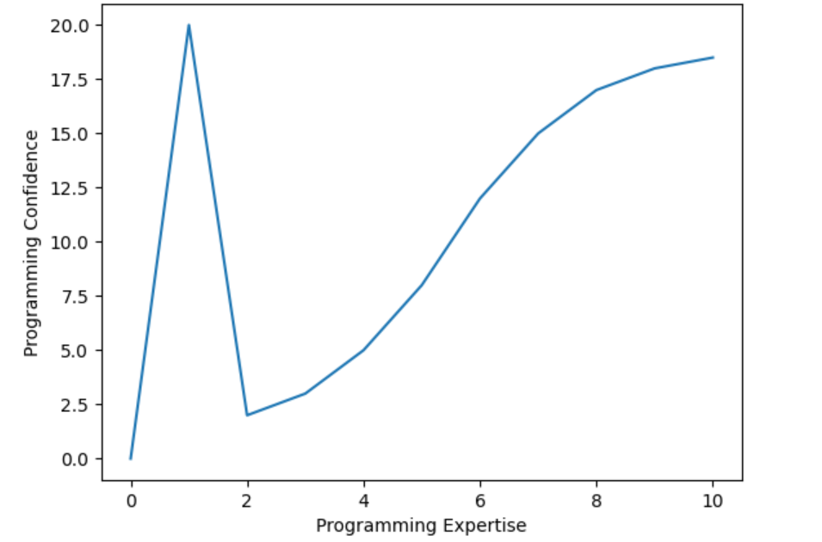
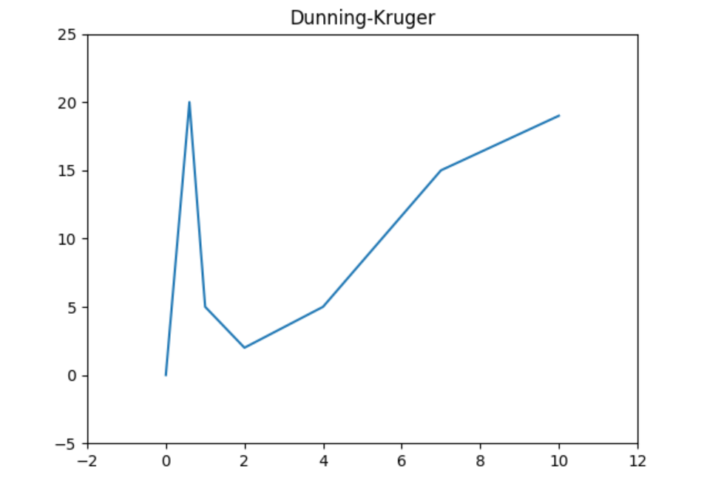
Plotting Basics
Most functions in Python are in the pyplot module.
from matplotlib import pyplot
pyplot.plot([0, 20, 2, 3, 5, 8, 12, 15, 17, 18, 18.5])
pyplot.xlabel("Programming Expertise")
pyplot.ylabel("Programming Confidence")
pyplot.show()
from matplotlib import pyplot
pyplot.plot([0,.6,1,2,4,7,10], [0,20,5,2,5,15,19])
pyplot.axis([-2, 12, -5, 25])
pyplot.title("Dunning-Kruger")
pyplot.show()
Notes:
5.5 min

Slide 4
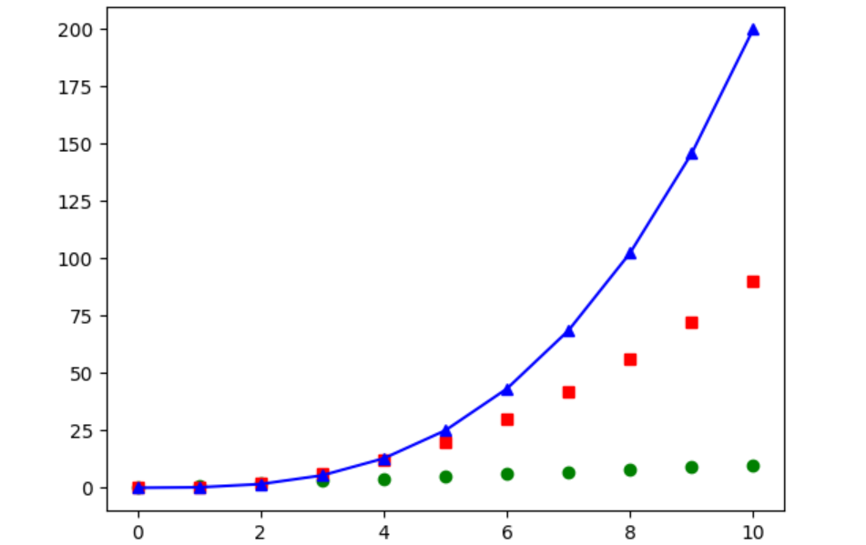
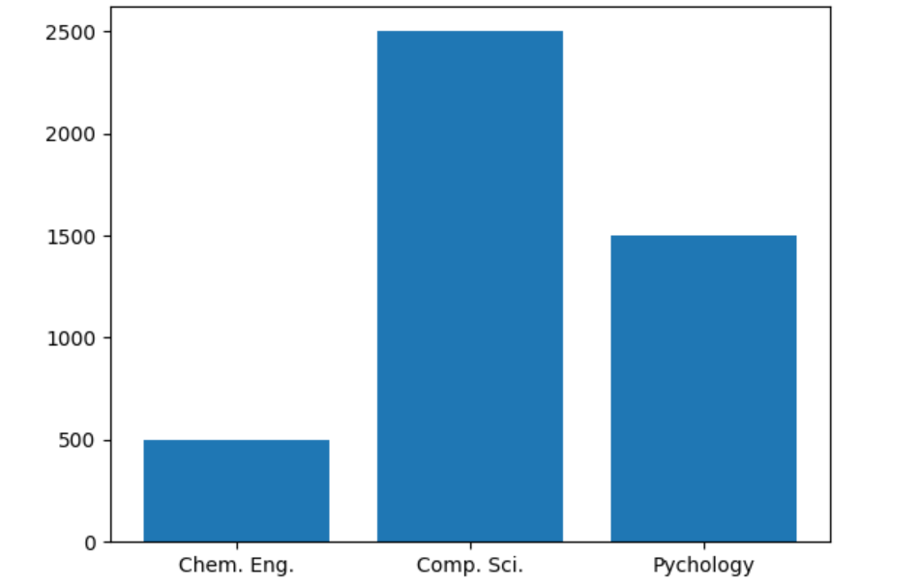
Formatting & Data Sets
We can format the visualization and use multiple data sets, too.
from matplotlib import pyplot
sq = [0.1 x * x for x in range(0, 11)]
cb = [0.2 * x ** 3 for x in range(0, 11)]
pyplot.plot(range(0, 11), "go", sq, "rs", cb, "b^-")
pyplot.show()
from matplotlib import pyplot
majors = ["Chem. Eng.", "Comp. Sci.", "Psychology"]
students = [500, 2500, 1500]
pyplot.bar(majors, students)
pyplot.show()
Notes:
6.5 min

Slide 5
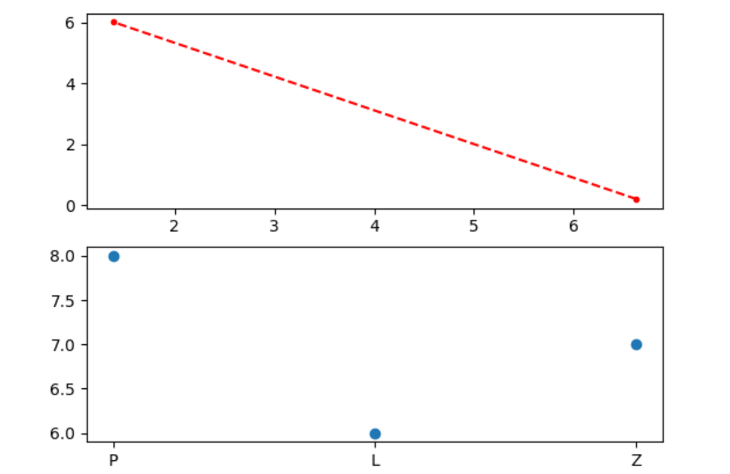
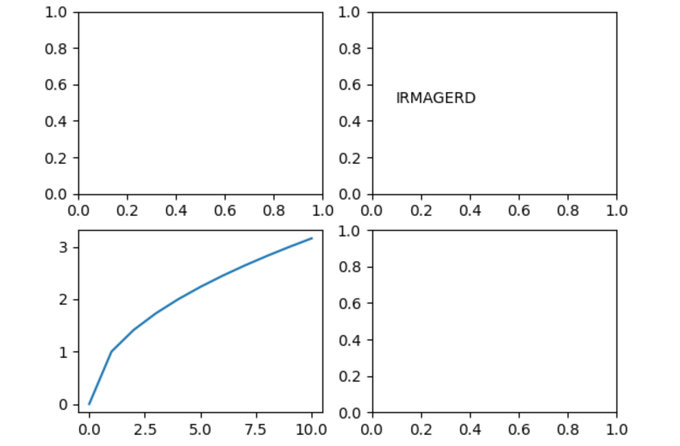
Figures and Axes Sets
Visual Figure objects are composed of one or more Axes sets objects.
from matplotlib import pyplot
fig, axes = pyplot.subplots(2,1)
axes[0].plot([6.63, 1.38], [0.21, 6.02], "r.--")
axes[1].scatter(["P", "L", "Z"], [8, 6, 7])
pyplot.show()
from matplotlib import pyplot
fig, axes = pyplot.subplots(2,2)
axes[1,0].plot([x ** .5 for x in range (0,11)])
axes[0,1].text(.1, .5, "IRMAGERD")
pyplot.show()
The current figure & axes set are available via pyplot.gcf() and pyplot.gca().
Notes:
Figure is space we can “draw” to; each axes set is used for a subplot. We can have many sub-plots or just one.
8 min
23 min

